Slide 1

QUICK_SHOP

Slide 2
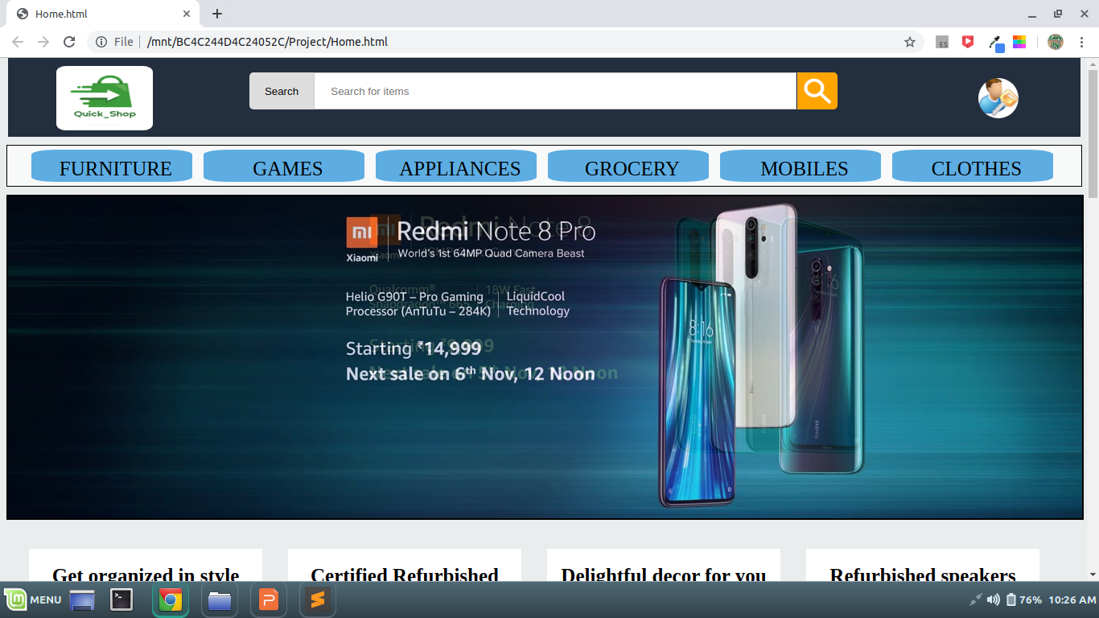
Home Page

Slide 3
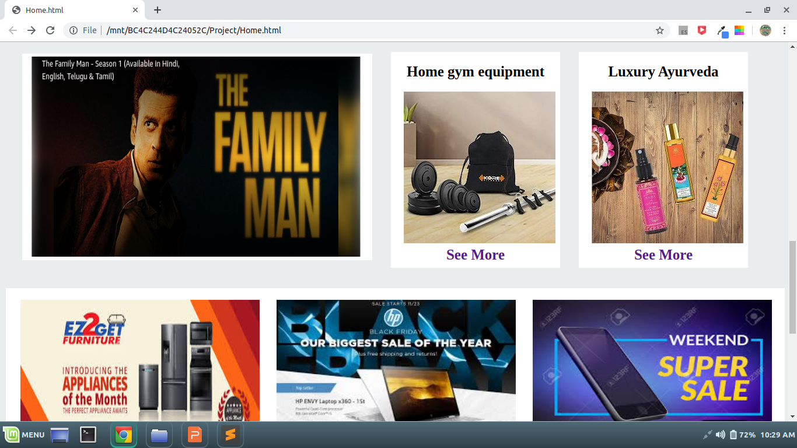
Mid section of Homepage

Slide 4
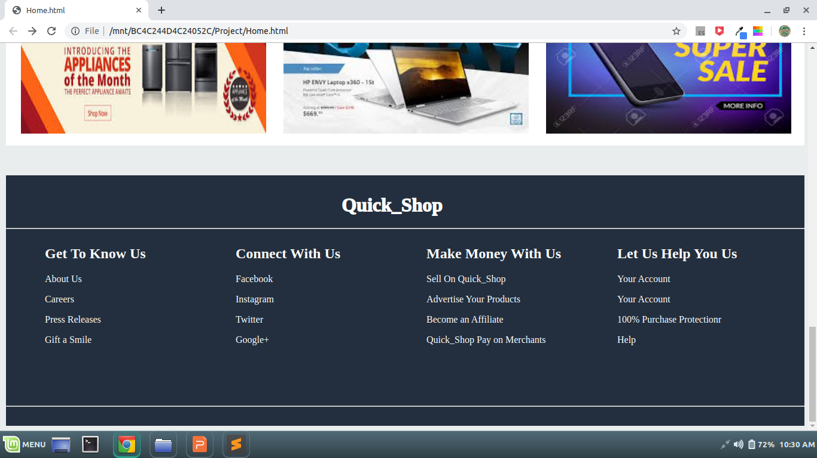
Footer Section

Slide 5
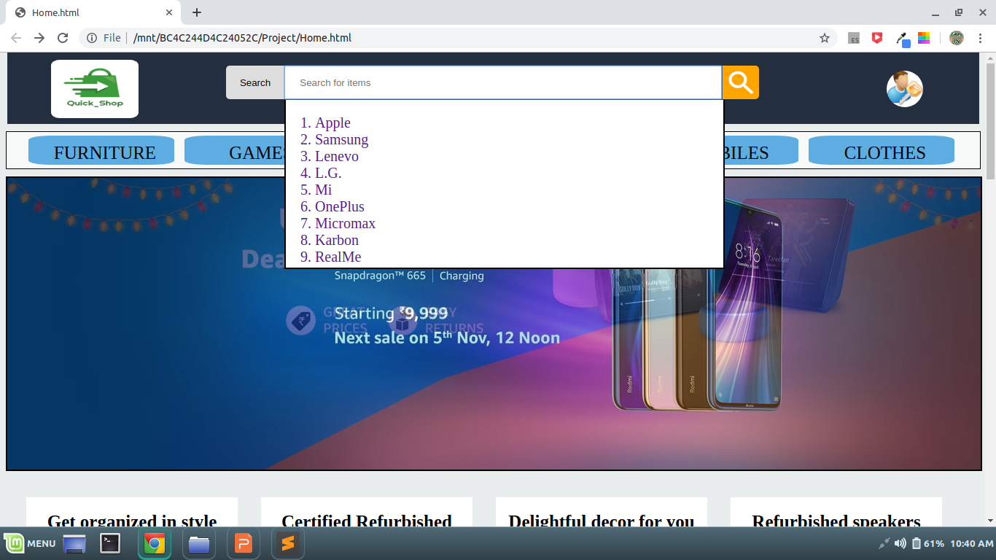
Search Bar

Slide 6
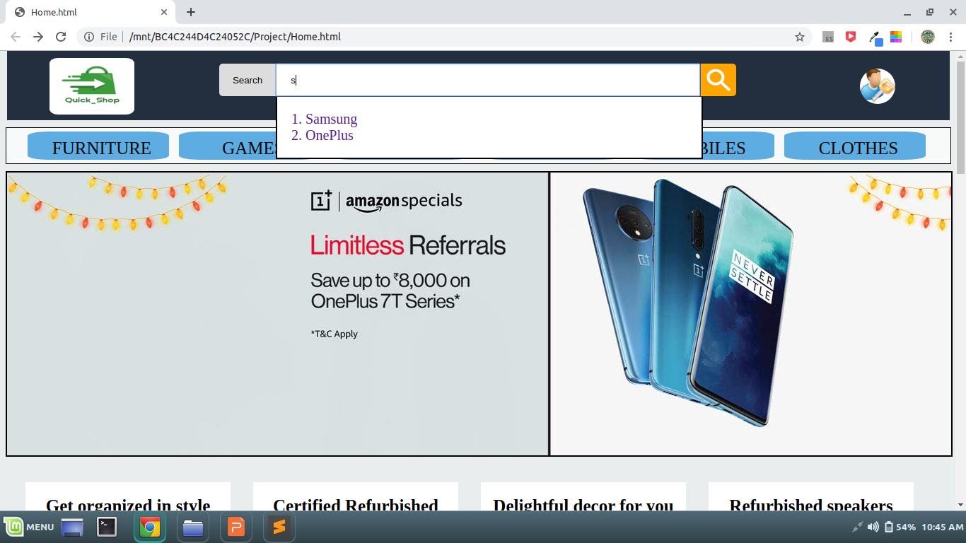
Searching Filter

Slide 7
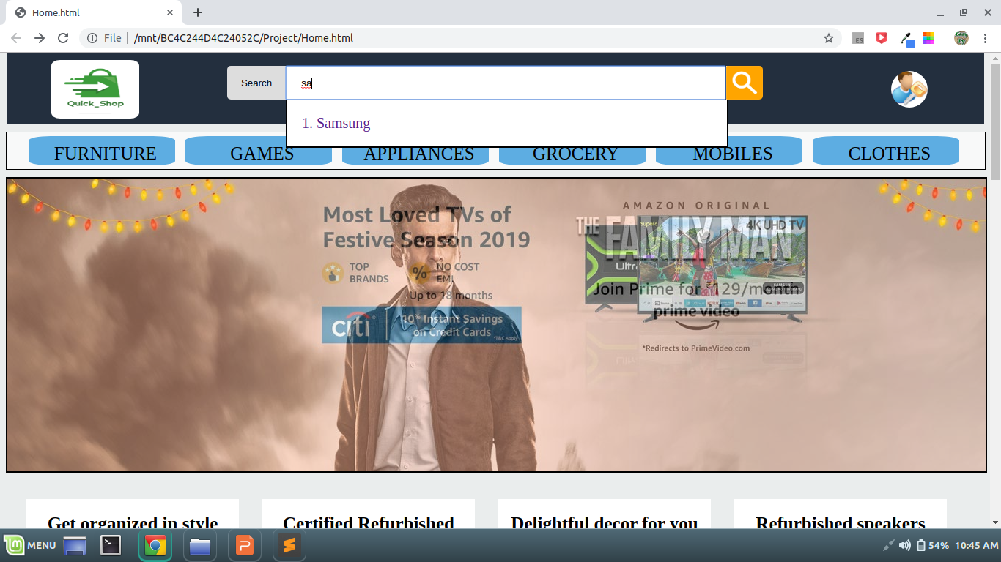
Result Matched

Slide 8
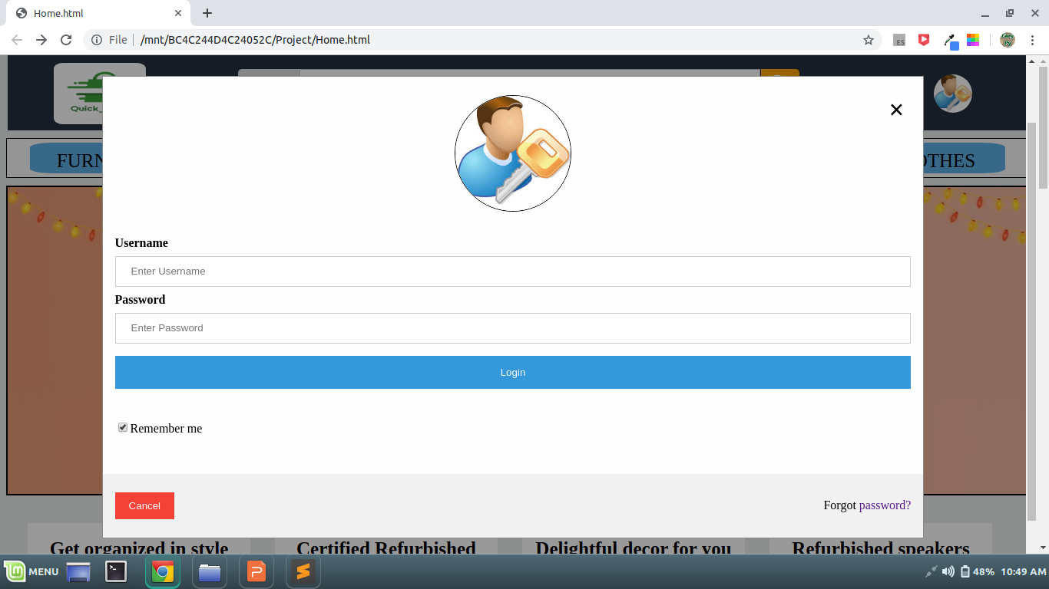
Login Page

Slide 9
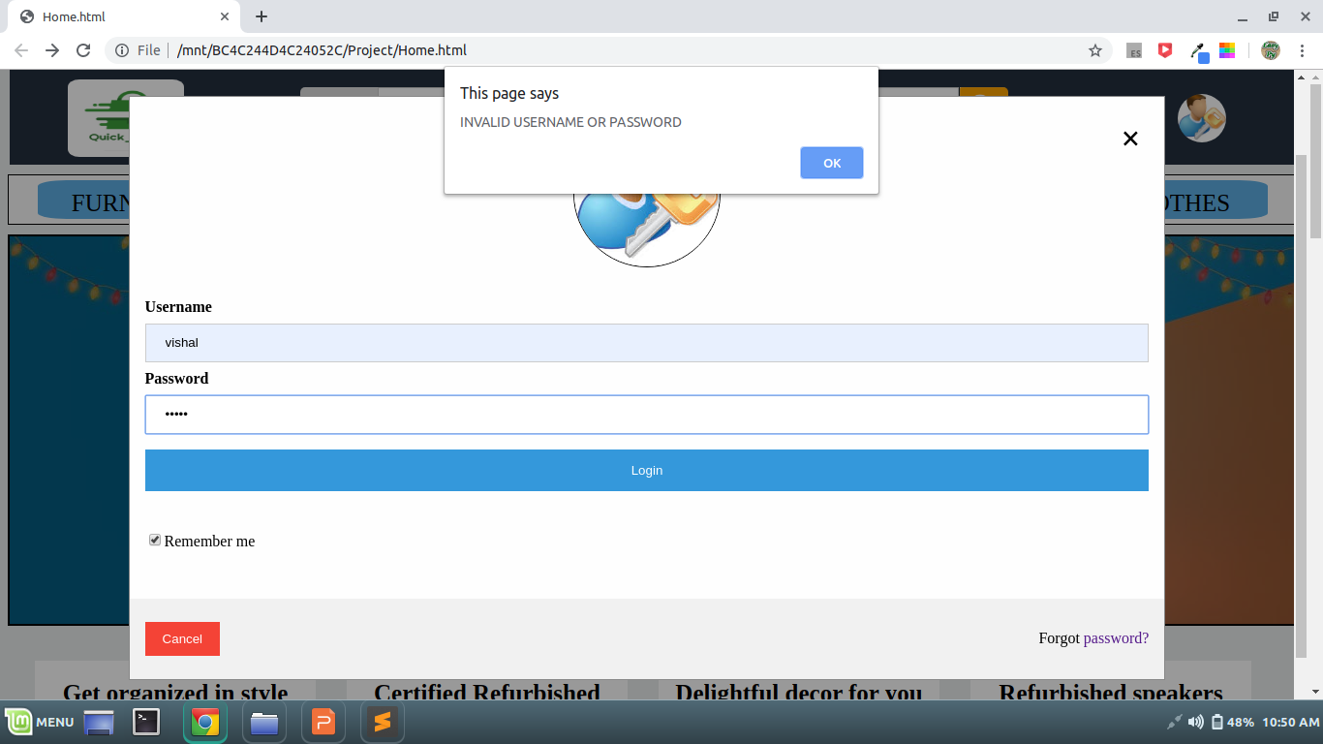
Login page Validation

Slide 10
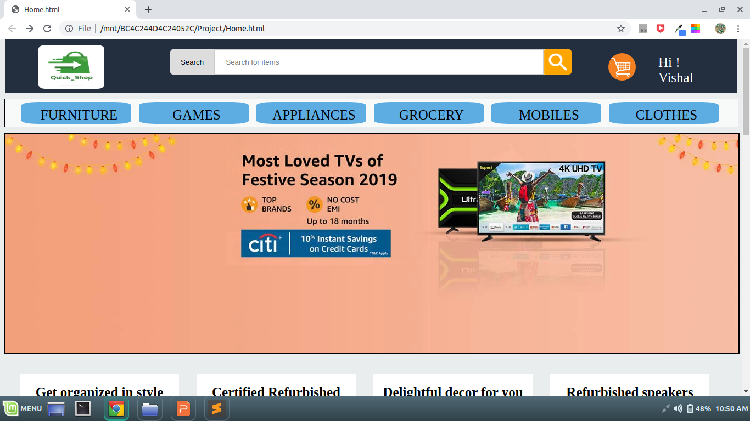
After Logged in

Slide 11
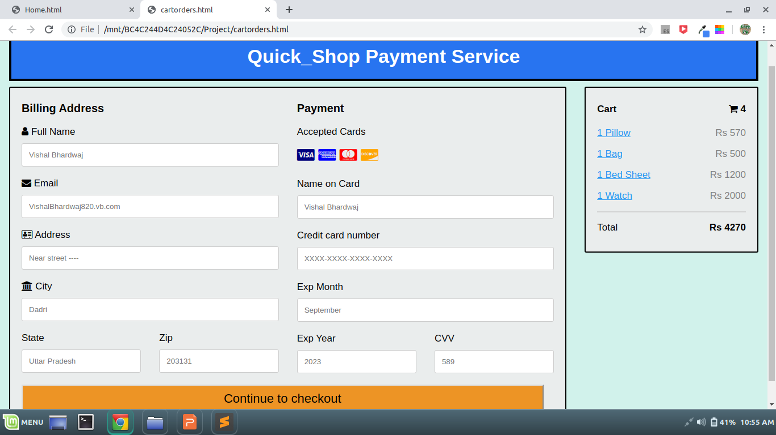
Cart Items

Slide 12
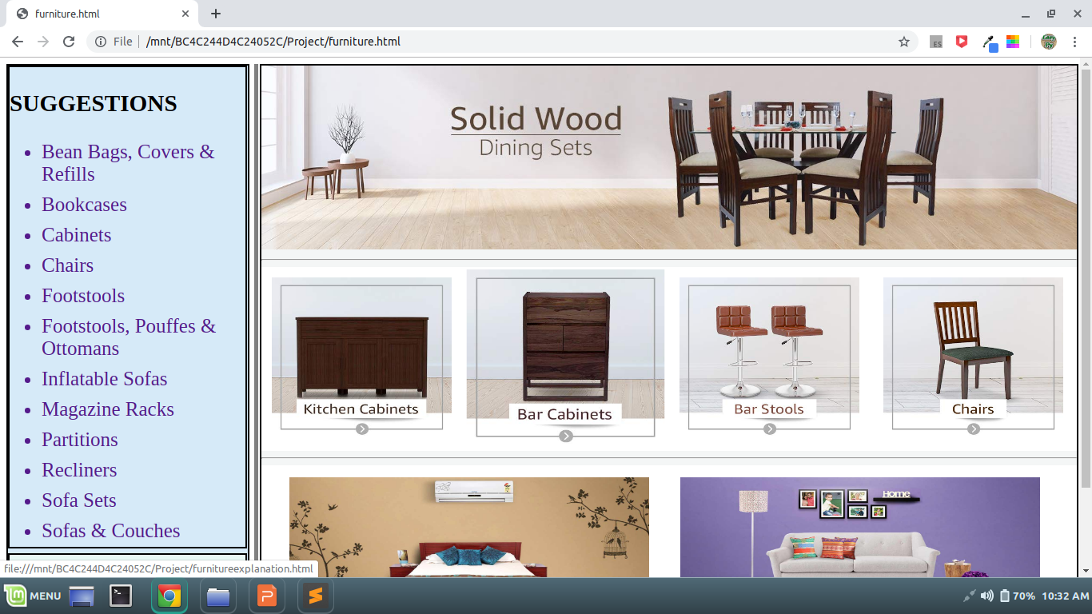
Furnitures Section

Slide 13
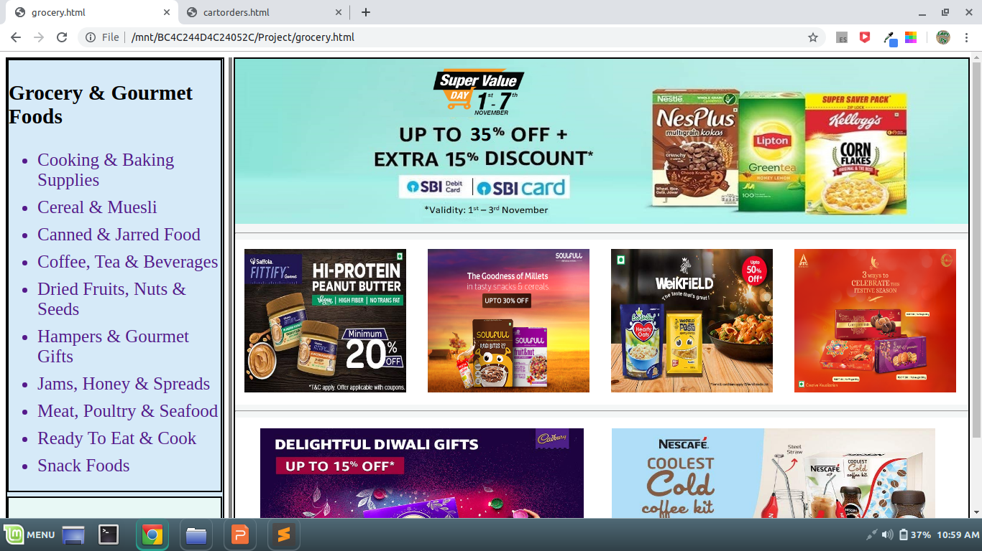
Grocery Section

Slide 14
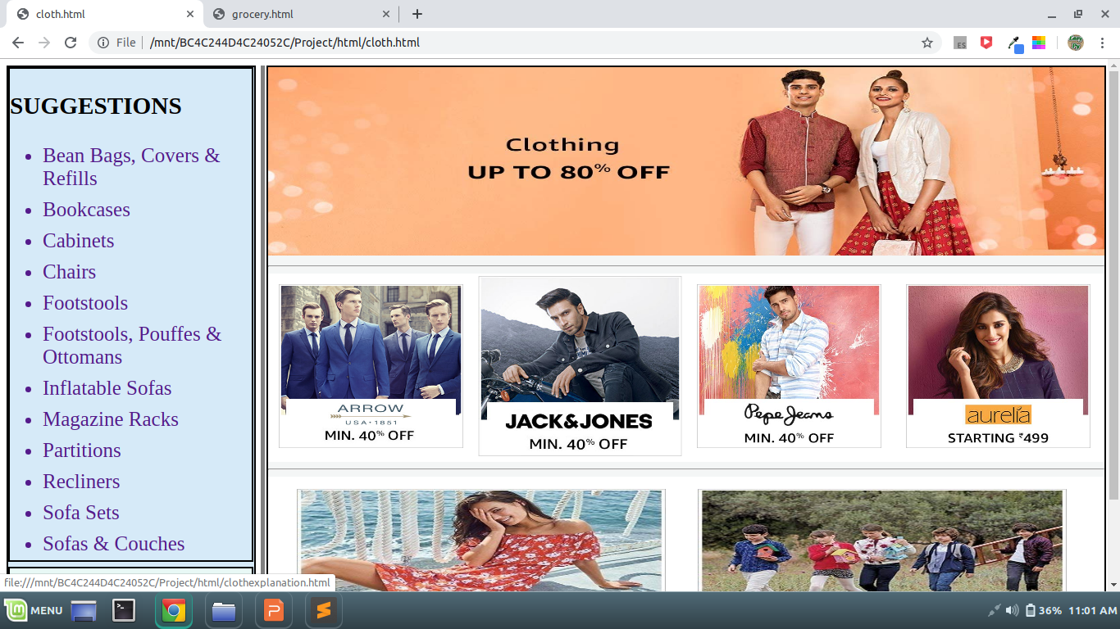
Clothes Section

Slide 15
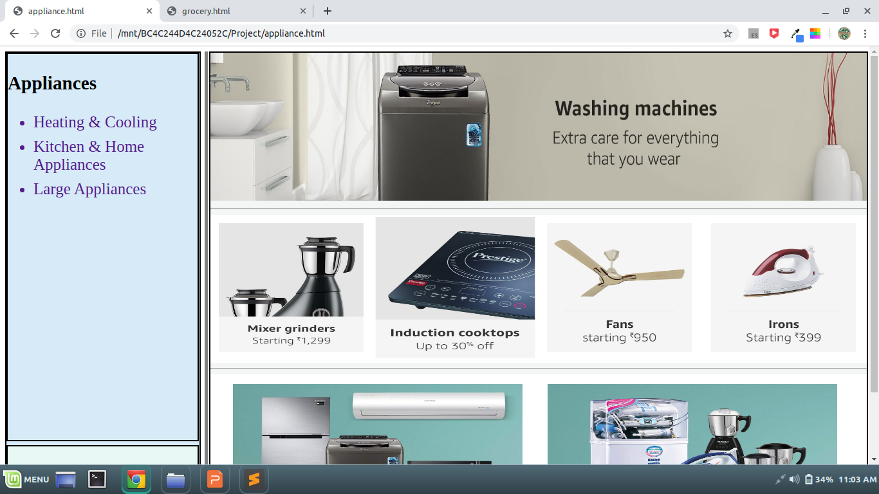
Appliances Section

Slide 16
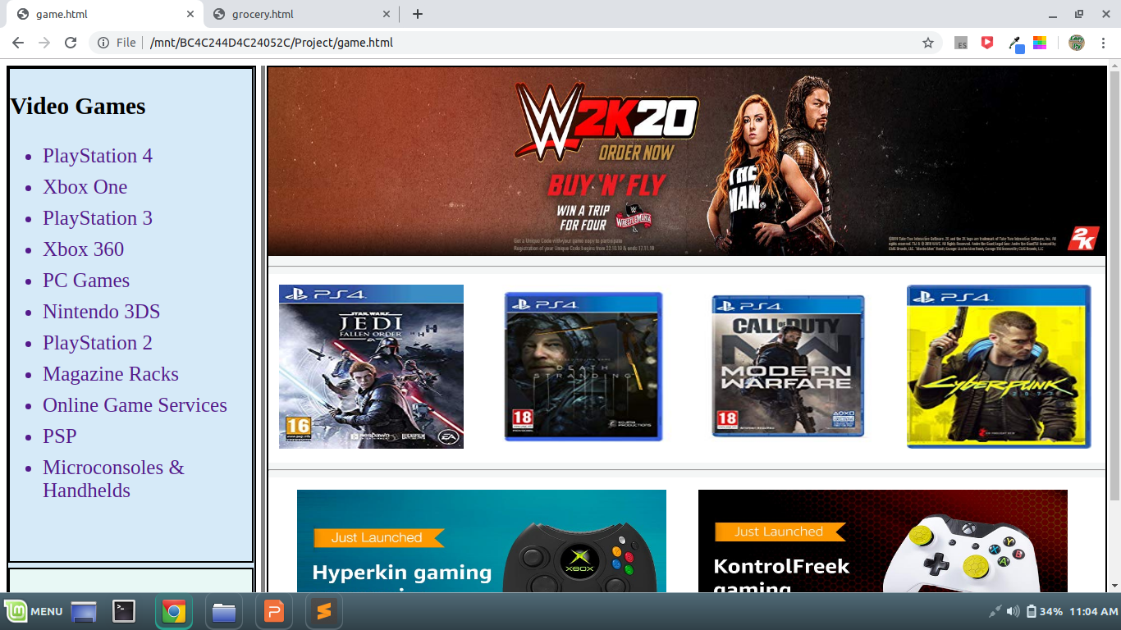
Games Section

Slide 17
Description of Modules

Slide 18
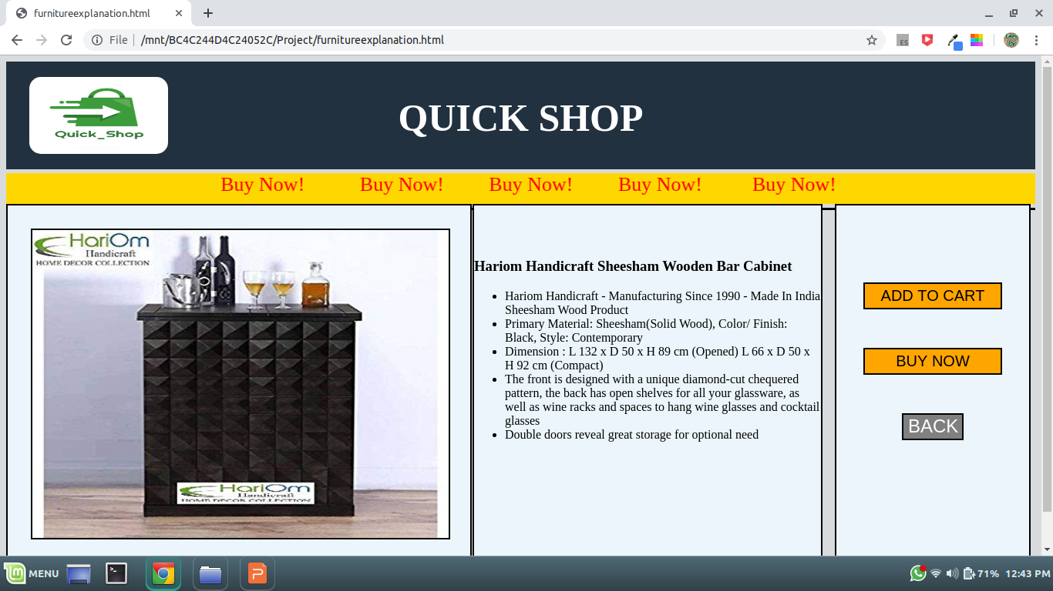
Furniture Description

Slide 19
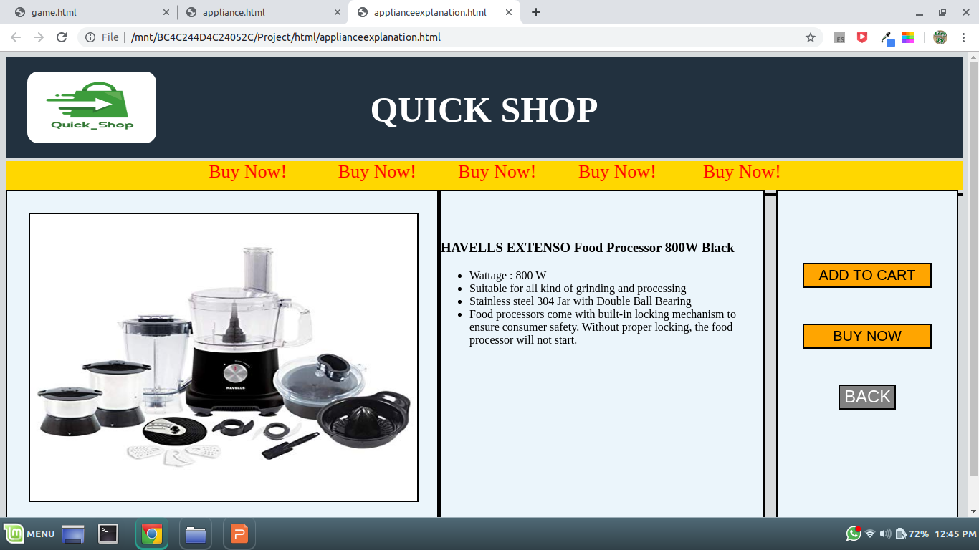
Appliances Description

Slide 20
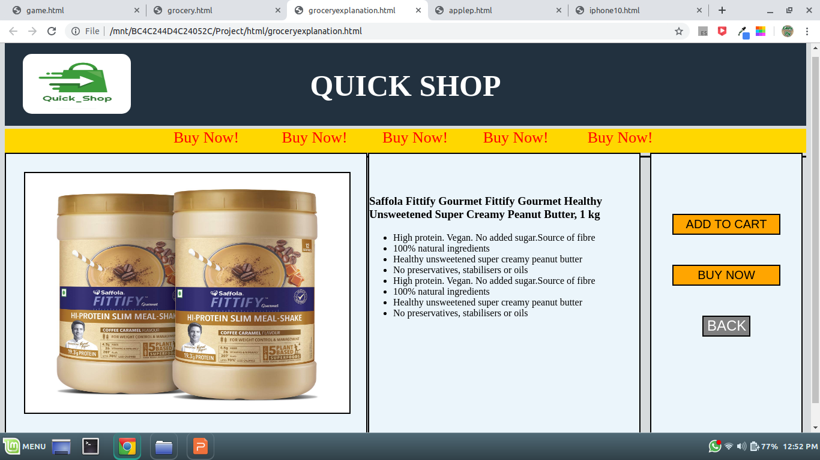
Grocery Description

Slide 21
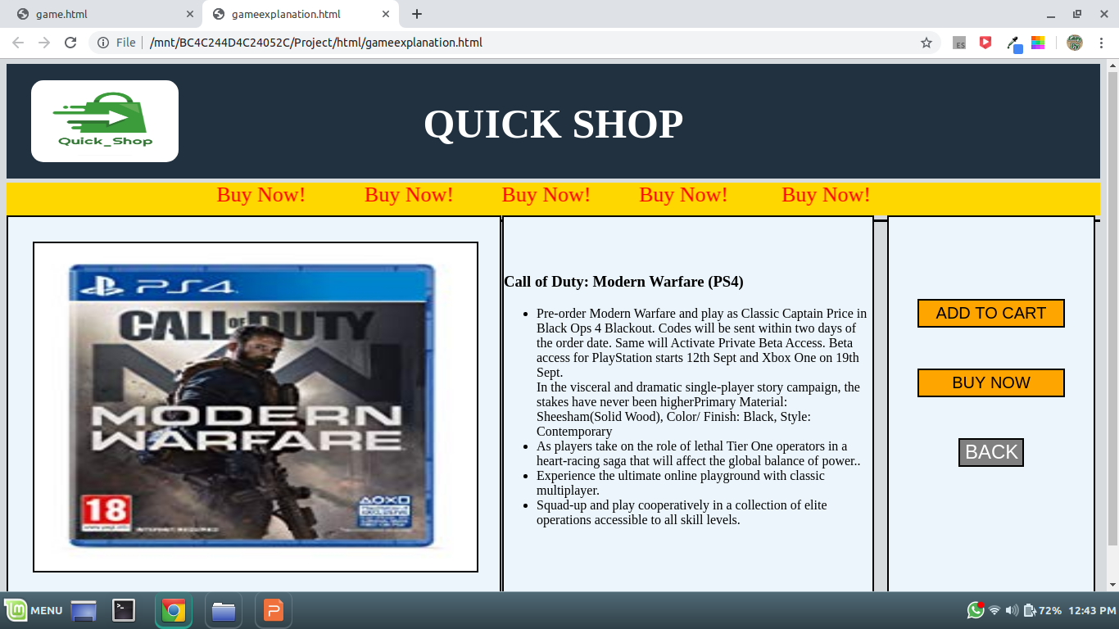
Game Description

Slide 22
Mobile Section

Slide 23
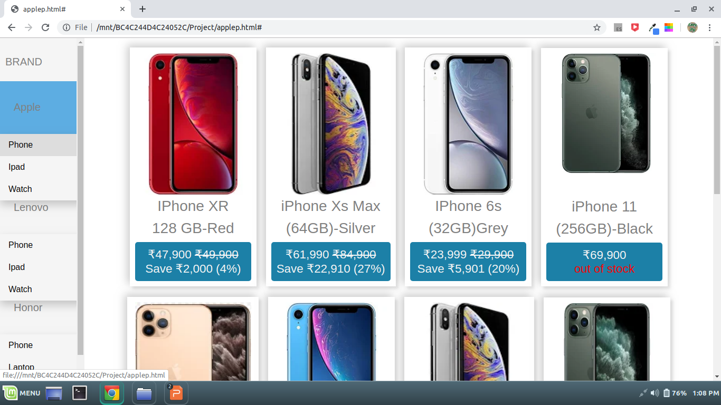
Iphones

Slide 24
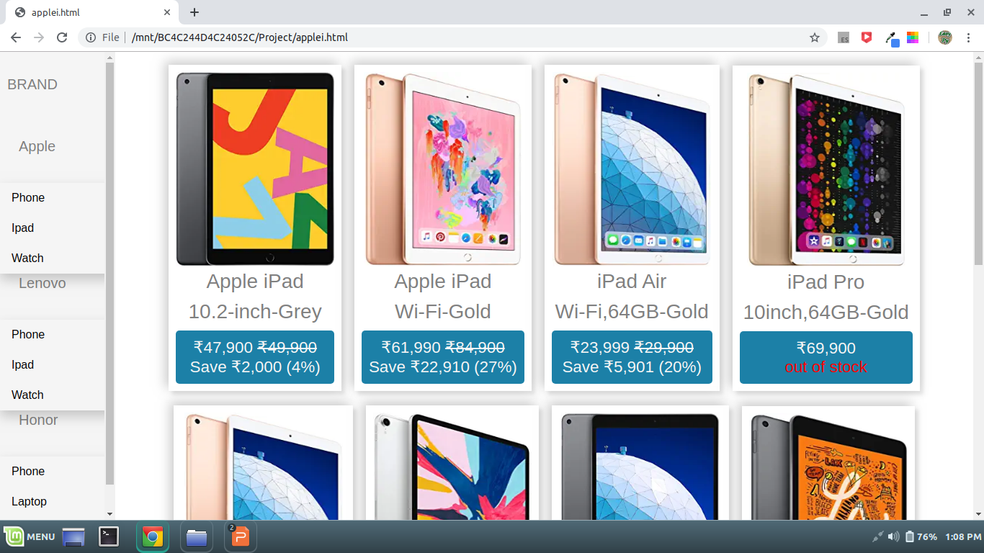
Ipads

Slide 25
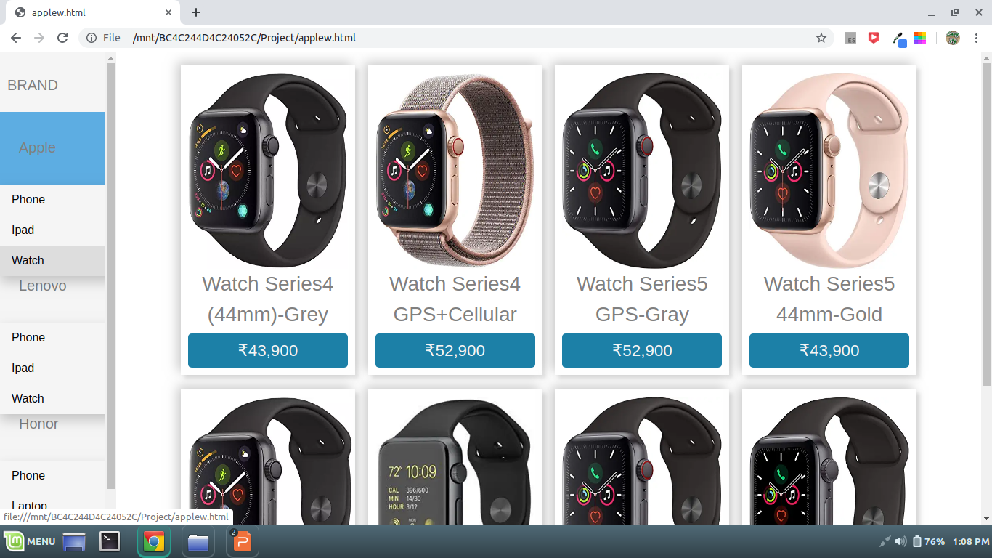
Watches

Slide 26
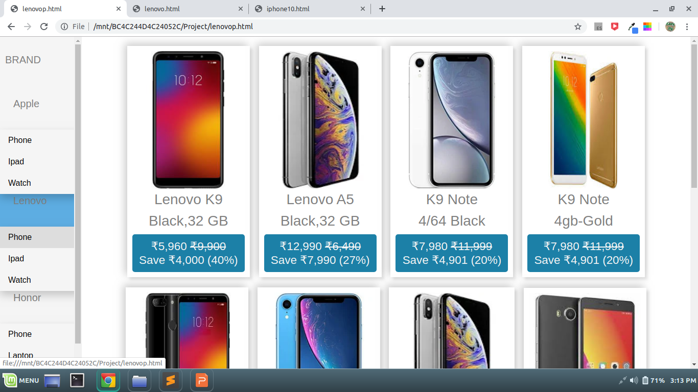
Lenovo phones

Slide 27
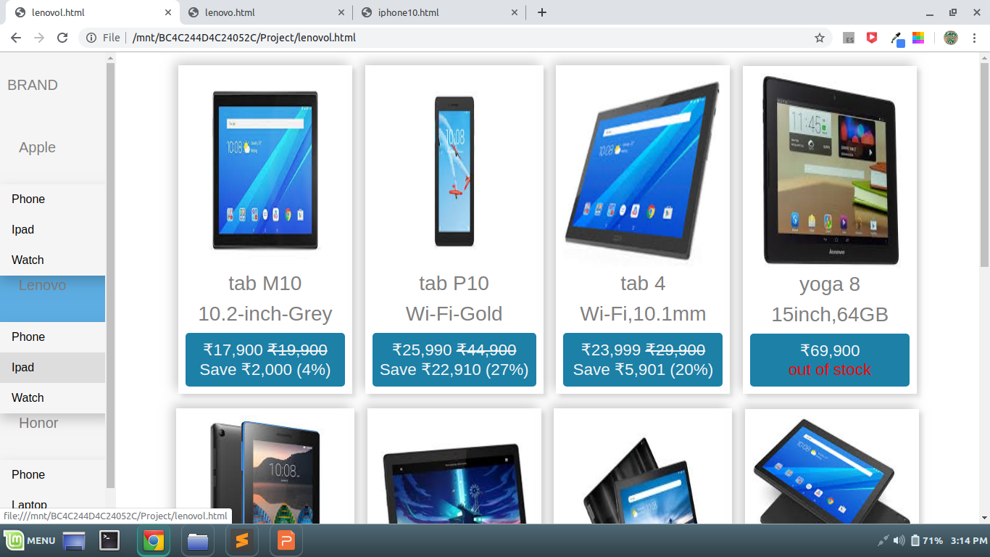
Lenovo Tabs

Slide 28
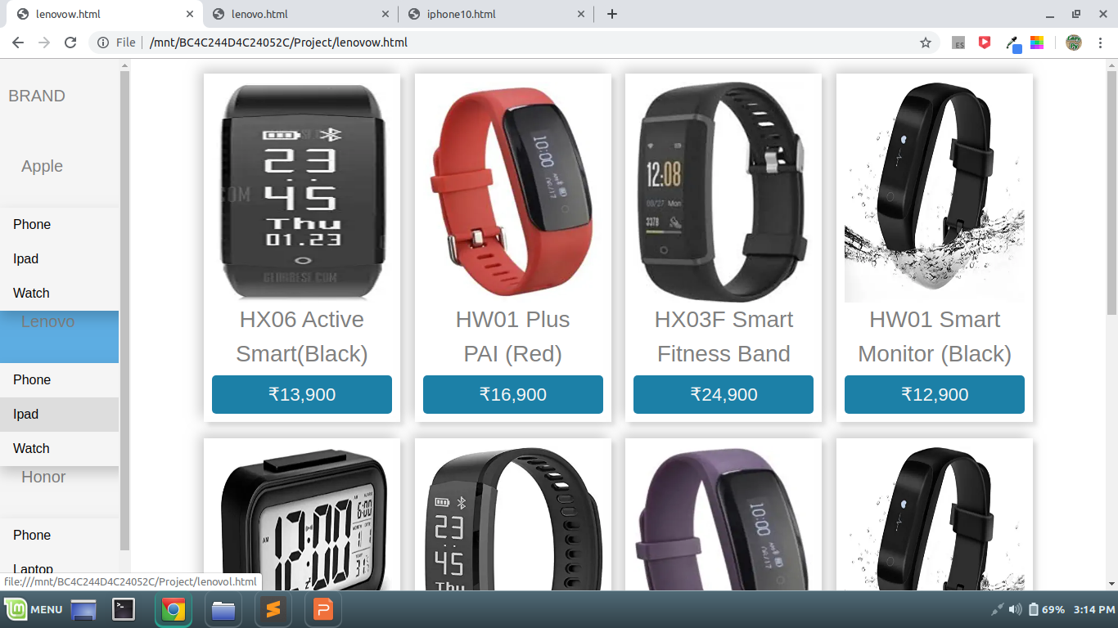
Lenovo Watches

Slide 29
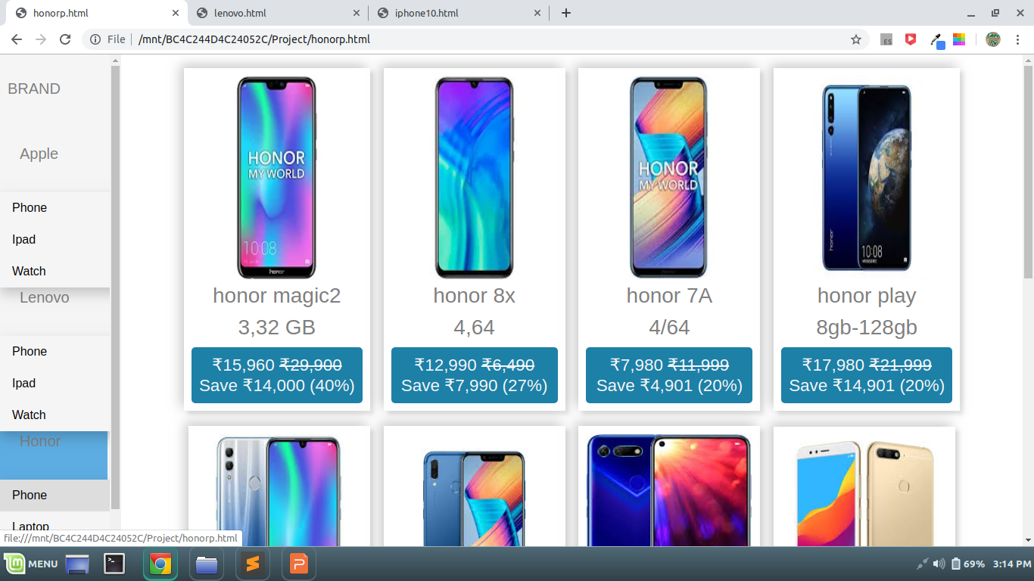
Honor Phones

Slide 30
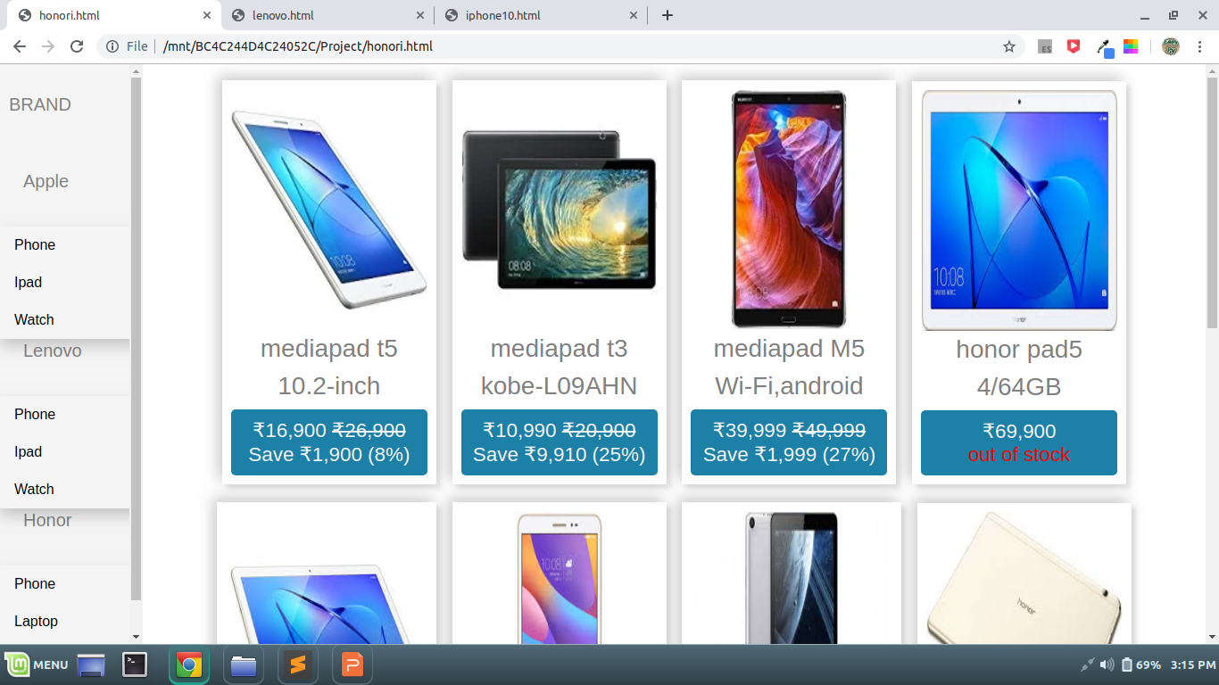
Honor Tabs

Slide 31
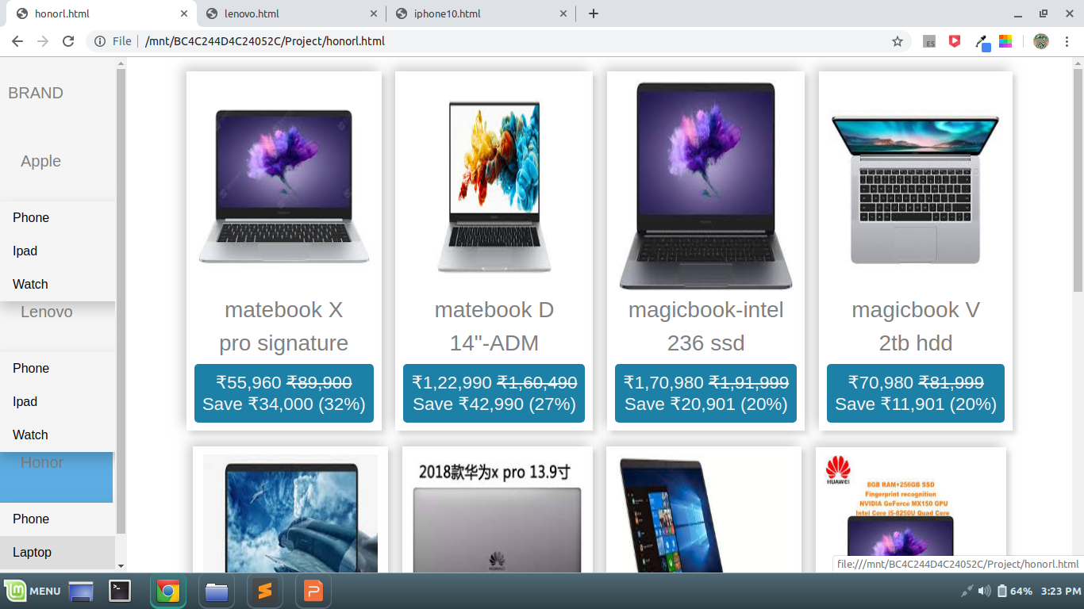
Honor Laptops

Slide 32
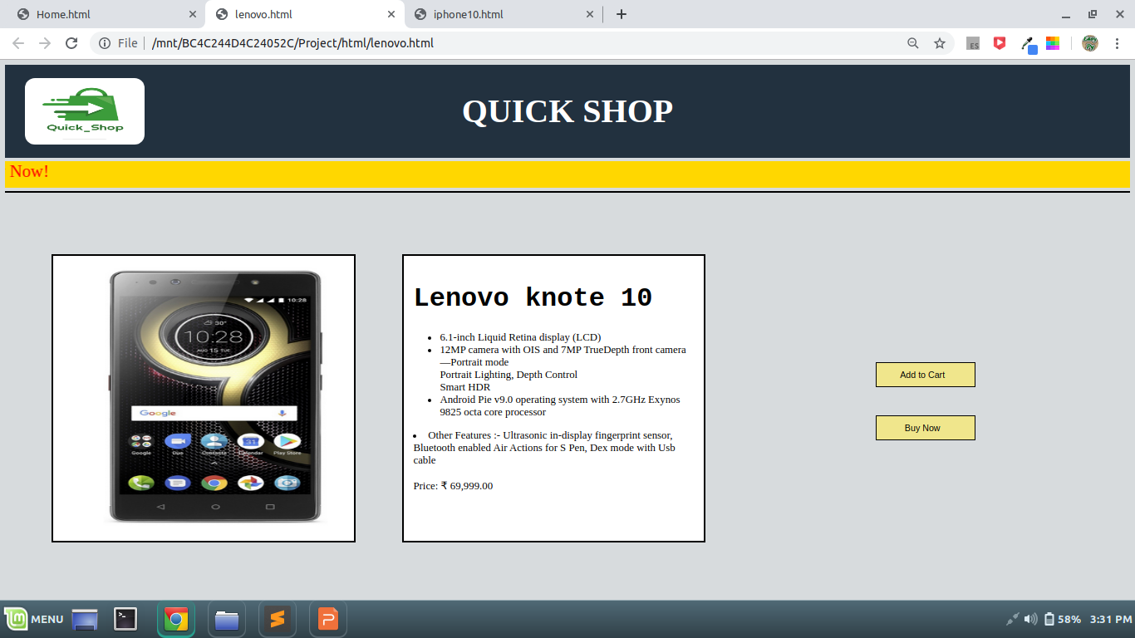
Phone Description

Slide 33
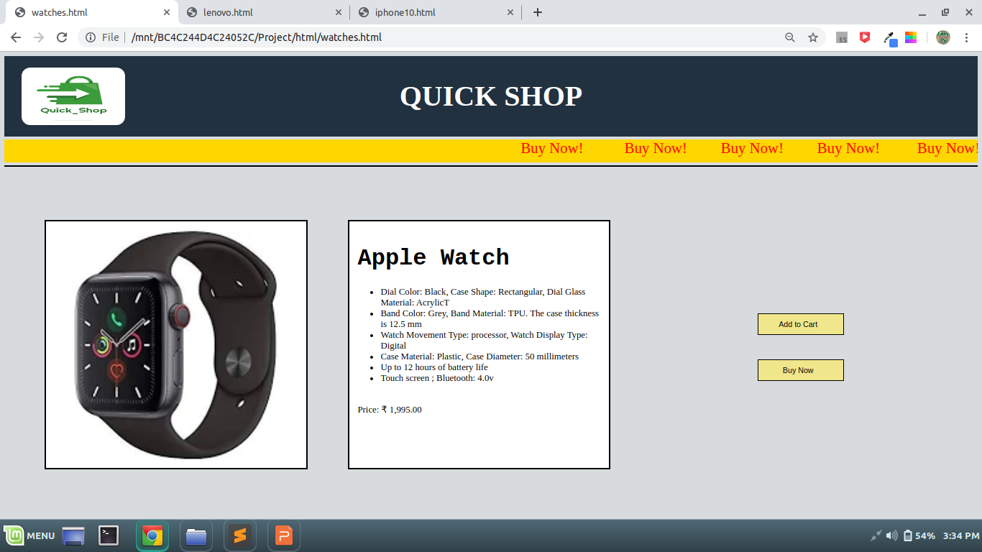
Watch Description

Slide 34
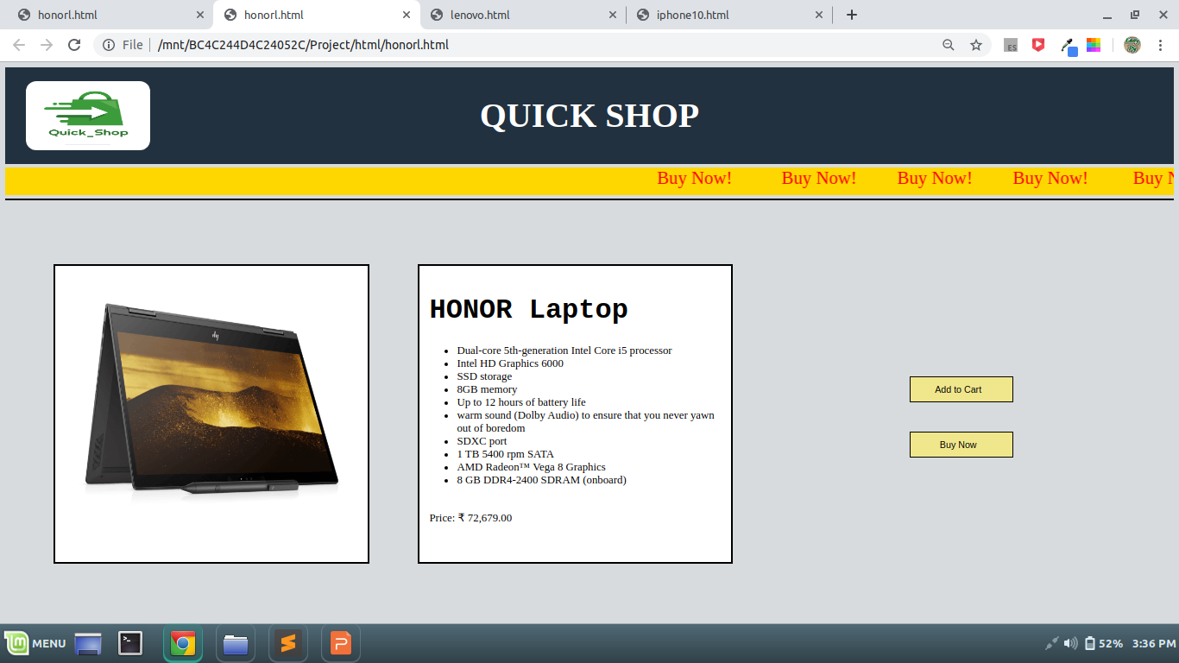
Laptop Description

Slide 35
Division of Project
Vishal Bhardwaj
i)Home page.
ii)Login Page.
iii)Furniture Section.
iv)Grocery Section.
v) Clothes Section.
vi)Appliances Section.
vii)Game Section.

Slide 36
Division of Project
Mausam(Mobile Section)
i)Iphone Section.
ii)Ipads Section.
iii)Watches.
iv)Lenovo phone.
v)Lenovo Tabs.
vi)Lenovo watches.
vii)Honor Tabs.
viii)Honor Laptops

Slide 37
Division of Project
Shashank Kumar
i)Furniture Description.
ii)Grocery Description.
iii)Games Description.
iv)Clothes Description.
v)Appliance Description.
vi)Mobile Description.
vii)Laptop Description.
viii)watches Description.

Slide 38
Github Link
Link
https://github.com/VishalBhardwaj820/Shopping-Website

Slide 39
End

